Slide 1
Knock Knock, Who’s There? Membership Inference on Aggregate Location Data
NDSS 2018
Apostolos Pyrgelis, Carmela Troncoso, Emiliano De Cristofaro

Slide 2
Content of the Paper
Membership inference attacks on aggregates of location data Is the location data of a target user part of aggregated data?
Modeling the problem as a game
Realization of the distinguishing task via machine learning classifier

Slide 3
Content of the Paper
Evaluate the attacks on two real-world mobility datasets for
Evaluate the attacks for three different prior knowledge settings
Evaluate privacy protection of defense mechanisms that guarantee differential privacy

Slide 4
Results of the paper
The level of privacy leakage depends on:
Adversary's prior knowledge
Characteristics of the data
Group size
Timeframe of aggregation
Time semantics
Membership inference is less successful with decreasing group sizes
Successful, if actual locations of a subset of users (including the target) are known Or when knowing past aggregates for the same groups

Slide 5
Results of the paper
Regularity in users’ movement and sparseness of the location eases the task for the adversary
Inference is easier for longer aggregation periods and regular mobility patterns
Differential Privacy mechanisms are overall successful at preventing membership inference
Mechanisms designed for time-series settings achieve better utility, at the cost of reduced privacy (Tradeoff!)

Slide 6
Contributions of the Paper
Generic methodology to study membership privacy in location aggregates
Formalization of membership inference as a distinguishability game
Distinguishing task realized via a machine learning classifier
Deployment of the methods to quantify privacy leakage on raw aggregates, using two real-world mobility datasets
Illustration how the techniques can be used to study the effectiveness of defense mechanisms aimed at preventing these tasks

Slide 7
Meaning of the Paper
How will the member size of an aggregated group impact the membership inference?
The smaller the group size, the easier the task
Which task is easier? The observed aggregates move regularly or irregular?
Regular structures are an easier task
Is the task easier the more information an adversary has about the users?
The more background information the easier the task
Do differential privacy mechanisms help?
Yes

Slide 8
Introduction
Location data enables mobility analytics in the context of “smart cities”
Analysts use aggregate location statistics to
Calculate average speed along a road
Generate live traffic maps
Estimate the number of people in a restaurant, predict availability, waiting times.
Uber Movement, Telefonica Smart Steps, factual.com
Apple (iOS, 3rd-party app devs) collect aggregate statistics about :
Emojis/Deep links/Locations

Slide 9
Introduction
These information are privacy sensitive
Aggregate location statistics violate the privacy of individuals that are part of the aggregates
This work: Membership inference attacks on location data
Is the location data of a target user part of aggregated data?

Slide 10
Motivation
Membership inference is a first step to other types of attacks on location aggregates,
Profiling (Alzheimer patients)
Localization (sensitive locations)
Providers can leverage membership inference to evaluate the quality of privacy protection on the aggregates before releasing them
Regulators can verify misuse of data
Aggregate location data has been released without permission

Slide 11
Distinguishability Game (DG)
Assumption
The number of users in some Region of Interest (ROIs) are released periodically within a given time interval
Model Membership Inference by means of a distinguishability game
Challenger
Generates location aggregates over various user groups
Adversary
Relies on this data
Has prior knowledge about the users
Tries to infer whether data of a particular user is
included in the aggregates

Slide 12
Distinguishability Game (DG)
Adversary selects the target user and sends him to the Challenger
Challenger randomly selects a subset of users (without target user)
Challenger draws a random bit:
If b==0: the challenger aggregates the location matrices of all users along with that of the target user
If b==1: select another random user not in the user subset and adds her data to the aggregates
The aggregate location time-series of users is sent back to the Adversary
Adversary tries to guess b

Slide 13







Distinguishability Game (DG)
Adversary
Challenger
Target user
b==1
b==0
Contains target user? Yes/No

Slide 14
Adversarial Prior Knowledge
Subset of Locations:
Observation and Inference coincide
Adversary knows the real locations of a subset of users, including the target user, during the inference period
Telecommunications service provider getting locations from cell towers
Mobile app provider collecting location data
Participation in Past Groups:
Adversary knows aggregates computed during an observation period, disjoint from the inference period
May or may not include the user
Increasing Difficulty

Slide 15
Adversarial Prior Knowledge
Same Groups as Released: (Continuous data release over stable groups)
Adversary knows the target user’s participation in past groups
The same groups are used to compute the aggregates during the inference period
Different Groups than Released: (Continuous data release over dynamic user group)
Adversary knows the user’s participation in past groups
These groups are not used to compute aggregates released in the inference period
Increasing Difficulty

Slide 16
Distinguishing Function
Is a target user part of the aggregates? (in/out)
Binary classification task
Utilize supervised machine learning classifier trained on the prior knowledge
Inputs:
Target user
“Challenge” = aggregate location time-series of users
Size of aggregation group (m)
Considered time period
Prior knowledge

Slide 17

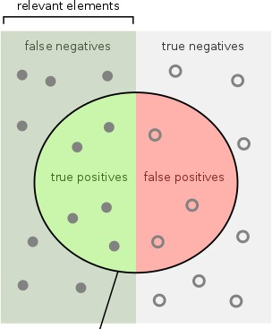
Privacy Metric
Privacy Loss:
Advantage in winning the DG over a random guess
Area Under Curve (AUC) score to measure the classifier’s performance
Area Under Curve (AUC) Score:
Count the adversaries guesses b’, compare to ground truth b
True Positive (TP) when b=0 and b’=0
True Negative (TN) when b=1 and b’=1
False Positive (FP) when b=1 and b=0
False Negative (FN) when b=0 and b’=1

Slide 18
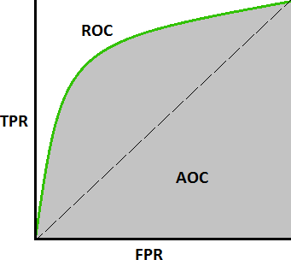
Privacy Metric
True Positive and False Positive Rate
TPR=TP/(TP+FN)
FPR=FP/(FP+TN)
Receiver Operating Characteristic (ROC) curve
Represents the TPR and FPR obtained at various discrimination classification thresholds
Area Under Curve (AUC):
Captures a classifier’s overall performance in the distinguishability game

Slide 19
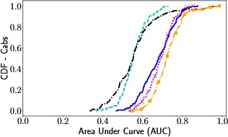
Privacy Metric
Paper plots the Cumulative distribution function (CDF) over the
Area Under Curve (AUC)
Accumulated (150) targets
Linear function
Slope 1

Slide 20
Datasets
Transport For London (TFL): (sparse, regular)
Trips made by passengers on the TFL network (March 1 - Sunday, March 28, 2010)
6M trips - 4M unique oyster cards - 582 stations (regions of interest - ROIs)
Sample the top 10K passengers ids per total # of trips → on average, 728 ± 16 ROIs in total
one hour granularity: Top 10K passengers are in 115 ± 21 out of the 672 timeslots (28 days)
When a user does not report any station at a particular time slot -> special ROI null ?

Slide 21
Datasets
San Francisco Cabs (SFC): (dense, irregular)
Mobility traces by San Francisco taxis from May 19 to June 8, 2008
Each record consists of a cab identifier, latitude, longitude, and a time stamp.
11M GPS coordinates - 534 cabs in SF – 3 weeks;
Grid 10×10 = 100 ROIs of 0.18 mi2
One hour granularity: the 534 cabs report over 2M ROIs, on average 3.827 ± 1.069 locations per taxi, out of which 78 ± 6
ROIs are unique
High frequency: Taxis are active for 340 ± 94 out of the 504 timeslots in the 21 considered days
1 if cab was in certain cell at time t and 0 otherwise

Slide 22
Sampling Users
Sort the users per total number of ROI reports (How many ROIs has one user visited)
Split users 3 groups of equal size (mobility patterns):
Highly mobile
Mildly mobile
Somewhat mobile
Sample 50 users from each mobility group at random
Membership inference attacks against 150 users for each dataset
How?
They are probably not evenly distributed
Does this really avoid bias?

Slide 23
Experimental Setup
Three phases: Aggregation, Feature extraction, Classification
Sample & Aggregate:
Sample groups that include and exclude the target user to create a balanced dataset of labeled aggregate location time-series
Feature Extraction: Extract various statistics from the time-series of each ROI
mean, variance, standard deviation, median, min, max, sum of values of each location’s time-series

Slide 24
Experimental Setup
Classification:
Train a classifier on the features extracted from the training set
Play the distinguishing game on the testing set
Classifiers: Logistic Regression, Nearest Neighbors, Random Forests, Multi-Layer Perceptron

Slide 25
Evaluating Membership Inference on Raw Aggregate Locations
Subset of Locations:
Adversary knows the real locations of a subset of users, including the target user during the inference period
This information to create groups, with and without target, and train a classifier
Observation/Inference period: First week of both datasets
Telecommunications service provider getting locations from cell towers
Generate balanced training dataset by:
Randomly sampling 400 unique user groups from Adversaries prior knowledge (1:1) (training)
Sampling 100 unique user groups from the set of users not in the prior knowledge (testing)

Slide 26
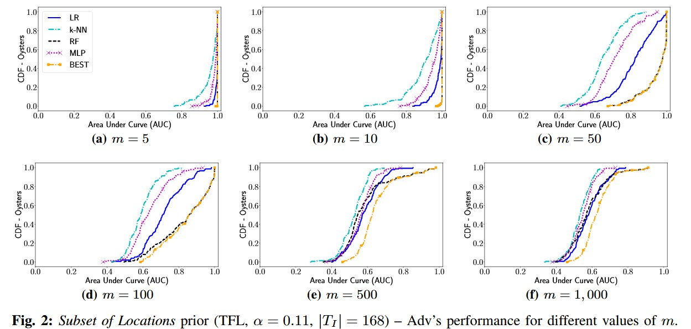
Transport For London

Slide 27
Transport For London
‘BEST’: Best case classifier that yields highest AUC score for each target user
Small groups -> high AUC scores for all classifiers
-> User’s contribution to the aggregates is very significant -> membership inference is very effective
Large groups -> Performance drops closer to the random guess baseline

Slide 28
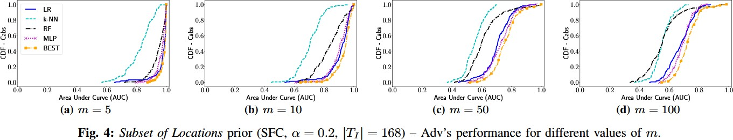
San Francisco Cabs
The results for SFC resemble the ones for TFL

Slide 29
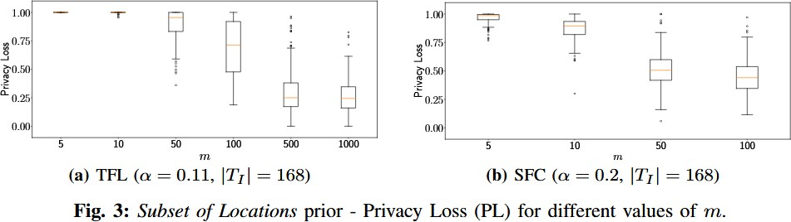
Transport For London

Slide 30
Transport For London
Small groups -> mean PL large Larger groups -> PL decreases -> Users enjoy better privacy when their data is aggregated in larger groups
Best classifier picked for each target user
For groups up to 100 users:
PL is larger on TFL than on SFC -> Membership inference is easier on sparse data
Why is the reason sparsity and not irregularity?

Slide 31
Participation in Past Groups
Same Groups as Released: (Continuous data release over stable groups)
Adversary knows the target user’s participation in past groups
The same groups are used to compute the aggregates during the inference period
Observation period:
TFL: first 3 weeks
SFC: first 2 weeks

Slide 32
Participation in Past Groups
Inference period is the last week of data (168 hourly timeslots)
Train the classifiers with features of each week in the training set
Test on features extracted from the aggregates of each group in the test set
There is no limitation of the prior -> Groups as large as the dataset
Does this mean they have a classifier for each observation week?
For large groups, target always in?

Slide 33
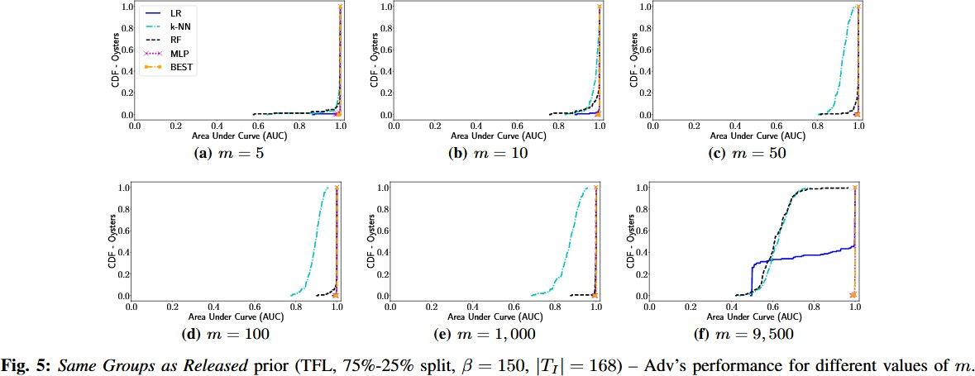
Participation in Past Groups

Slide 34
Participation in Past Groups
Small groups -> high AUC scores for all classifiers (AUC scores over 0.9) m>50: k-NN slightly decreases in performance compared to the others m=9500: MLP outperforms
Regular mobility patterns -> Successful membership inference, even if they are larger (For an adversary with prior knowledge about specific groups and the groups are maintained)

Slide 35
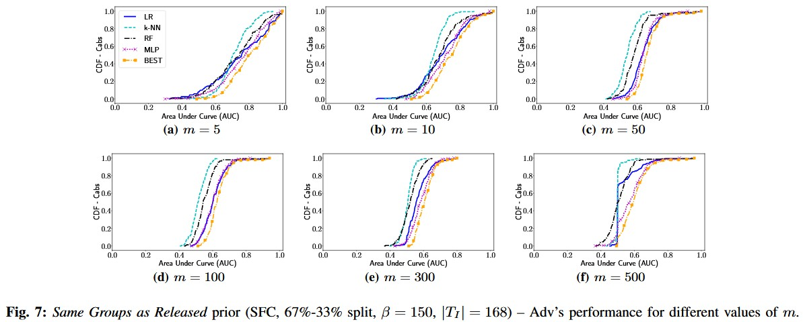
Participation in Past Groups

Slide 36
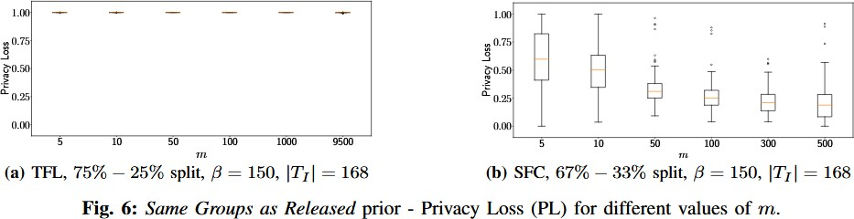
Participation in Past Groups
Best classifier picked for each target user

Slide 37
Participation in Past Groups
Large privacy loss for users aggregated in groups for which the adversary has prior knowledge
Regularity has a strong effect on membership inference
Cabs lose privacy when they are aggregated in small groups
Irregularity -> The loss drops drastically with larger groups
Irregularity makes inferring membership harder

Slide 38
Participation in Past Groups
Note for m=500
Due to larger groups there is an overlap across groups, which effectively creates somewhat “artificial” regularity

Slide 39
Participation in Past Groups
Different Groups than Released: (Continuous data release over dynamic user group)
Adversary knows the user’s participation in past groups
These groups are not used to compute aggregates released in the inference period
For each target user, generate a dataset with the aggregates of 400 unique randomly sampled groups (1:1)
75%-25% stratified random split on the dataset;
300 groups for training and 100 groups for testing.
Observation period: first 3 weeks for TFL; first 2 weeks for SFC
Inference period is the last week of data (168 hourly timeslots)
Split the training and testing sets according to time

Slide 40
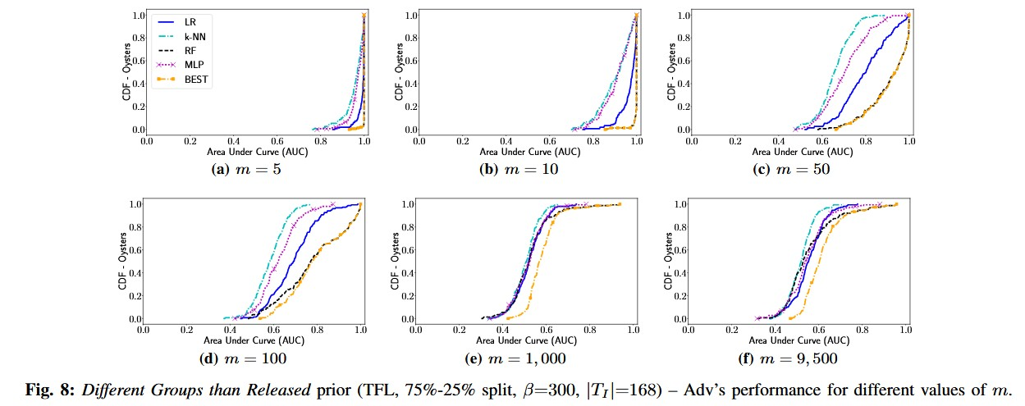
Participation in Past Groups
Small groups (5, 10) -> high AUC scores
Increasing m ->small drop in adversarial performance-> Regularity still helps membership inference in small groups even when these groups change

Slide 41
Participation in Past Groups
m=1000 all the classifiers perform, on average, similar to the baseline
Regularity has no effect
m=9500 small increase in the classifiers AUC scores due to the big user overlap across training and testing groups
The different-groups prior becomes more similar to the same-groups prior

Slide 42
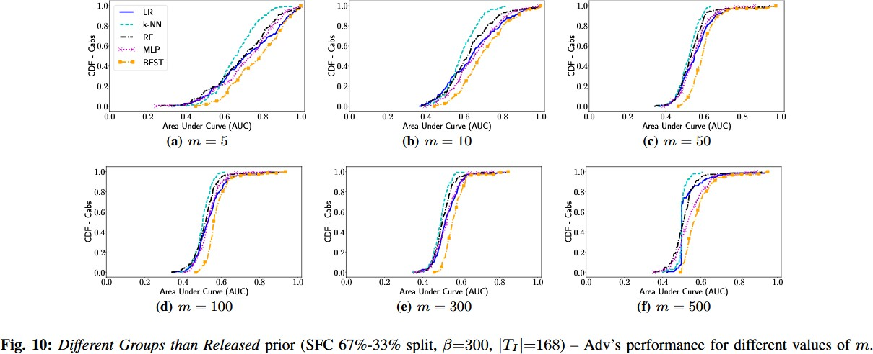
Participation in Past Groups
Irregularity: Classifiers perform worse for SFC than TDL
Small groups: mean AUC drops to 0.71 for the best classifiers, LR and MLP
With larger groups the performance is significantly lower, near random baseline

Slide 43
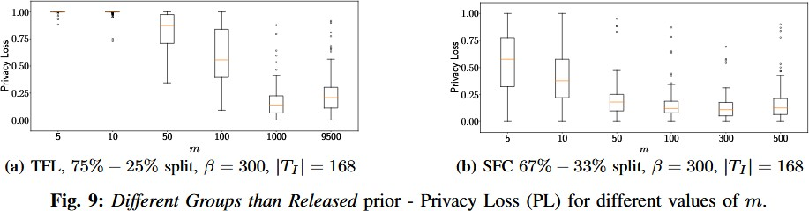
Participation in Past Groups

Slide 44
Participation in Past Groups
Up to m=100 Membership inference is quite effective privacy loss of at least 0.95
m>100 mean PL decreases
Overall: Privacy loss is smaller in this setting
Weaker adversarial setting than the previous one
Weaker prior: PL values are overall smaller compared to the previous setting
PL decreases with increasing aggregation group size

Slide 45
Length of Inference Period
Examine the effect of the inference period length
Consider lengths of 1 week (168 hourly timeslots), 1 day (24 timeslots), and 8 hours (8 timeslots)
For the last two, also consider working vs weekend
Only report experiments in the “Same groups as released” setting
Fix the group size to 1000 commuters for TFL and to 100 cabs for SFC
For each target user create a dataset of 150 random unique groups
Choose Random Forest for TFL and MLP for SFC

Slide 46
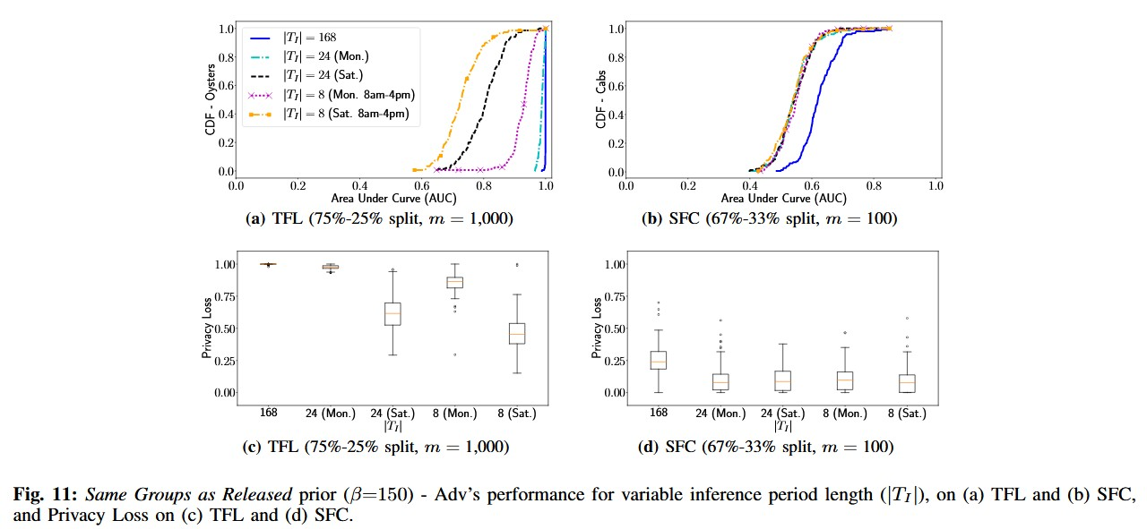
Length of Inference Period

Slide 47
Length of Inference Period
a)
Shorter inference period -> lower adversarial performance -> less information about mobility patterns to be exploited
Difference between working days and weekends (Monday: Mean AUC is 0.97; Saturday: 0.8)
Monday 8am-4pm: better results than on a Saturday (same time frame)

Slide 48
Length of Inference Period
b)
Irregularity -> lower adversarial performance
Irregularity -> no significant difference between working days and weekdays Irregularity -> no significant difference when considering full days vs 8 hour slots Shorter inference period -> lower adversarial performance

Slide 49
Length of Inference Period
c)
Longer periods -> higher privacy
Regularity in working days -> better membership inference attacks
d)
Smaller PL for SFC cabs, for all period lengths
Irregularity -> No significant difference between Mondays and Saturdays

Slide 50
Raw Aggregates Evaluation – Take Aways
The actual level of privacy leakage depends on:
Adversary's prior knowledge
Characteristics of the data
Group size
Timeframe of aggregation
Less successful with decreasing group sizes
Exception: Due to the regularity of commuters in the TFL case, attack still very effective for large groups
Successful, if actual locations of a subset of users (including the target) are known
Or when knowing past aggregates for the same groups

Slide 51
Raw Aggregates Evaluation – Take Aways
Privacy leakage on TFL is larger than on SFC
Regularity in users’ movement and sparseness of the location signals significantly ease the task
The length, as well as the time semantics, of the inference period play an important role
Inference is easier if the aggregates of longer periods are released and at times when mobility patterns are likely to be more regular

Slide 52
Evaluating Defenses
Differential Privacy: Define private functions that are free from inferences
Only a bounded amount of information is disclosed upon its release
Can mitigate membership inference attacks
Sensitivity: Captures how much one record affects the output of a function
Laplacian Mechanism (LPA):
randomize the aggregate statistics using random noise independently drawn from the Laplacian distribution
A weaker version of LPA for time-series, which perturbs the counts of a time-series = Baseline

Slide 53
Evaluating Defenses
Gaussian Mechanism:
Perturbing the statistics with random noise drawn from the Gaussian distribution
Fourier Perturbation Algorithm (FPA):
Performs the noise addition on the compressed frequency domain
Enhanced Fourier Perturbation Algorithm with Gaussian Noise (EFPAG):
Improves FPA

Slide 54
Experimental Design
Evaluate the effectiveness of differentially private mechanisms in defending against membership inferences
Evaluate over large groups
for small groups, the loss of utility incurred by DP-based mechanisms is prohibitively high
For larger groups membership inference is already weak

Slide 55
Experimental Design
The sensitivity of the location aggregation function, directly affects the amount of noise to be employed and does not depend on the group size
Aggregate time-series of groups with few users, which naturally have small counts, are affected more by the noise required by the DP-based mechanism

Slide 56
Evaluating Differentially Privacy (DP) Mechanisms
Worst-case adversary that obtains perfect prior knowledge for the users
given raw aggregates she can train a classifier that achieves AUC score of 1.0
Modification to the game: the challenger applies a DP mechanism before sending the challenge to the adversary
LPA, GSM, FPA, EFPAG

Slide 57
Evaluating Differentially Privacy (DP) Mechanisms
Evaluate the privacy/utility tradeoff of differentially private mechanisms considering:
Best setting for utility
Worst setting for privacy
Evaluate the gain in privacy on two cases: Adversaries classifier is trained on
The raw aggregates of the groups to be released (passive adversary)
Noisy aggregates of the groups to be released using the defense mechanism under examination(active adversary)

Slide 58
Experiment Settings
Membership inference against 150 sampled users
Observation/Inference period: first week in each dataset
Favorable setting for the utility of DP-based mechanism:
construct large user groups m=9500 for TFL, m=500 for SFC

Slide 59
Experiment Settings
Generate dataset by randomly sampling 200 and 400 elements for TFL and SFC (1:1)
Classifier: MLP
For Perturbation mechanism: Compute sensitivity for users in each dataset
= maximum number of ROIs reported by an oyster/cab in the inference week

Slide 60

Metrics
Privacy Gain:
Relative decrease in the adversary’s performance when challenged on perturbed aggregates vs. raw aggregates

Slide 61

Metrics
Utility: Mean Relative Error (MRE)
MRE computed between the raw aggregate time series and its perturbed version
The higher the better? The lower the better?

Slide 62
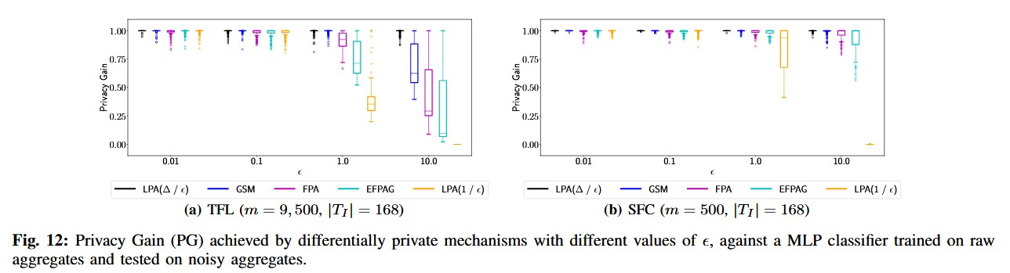
Results
Train on raw/ Test on Noisy Aggregates
low ε values (up to 0.1): all mechanisms provide excellent privacy protection
But poor utility (Table 2)
As eps increases to 1 LPA(Δ/ε) and GSM still provide good protection

Slide 63
Results
Train on raw/ Test on Noisy Aggregates
ε up to 1: high PG for all mechanisms But poor Utility
ε =10: mean PG is almost 1 for LPA(Δ/ε) and GMS,
Users are well protected against MIA

Slide 64
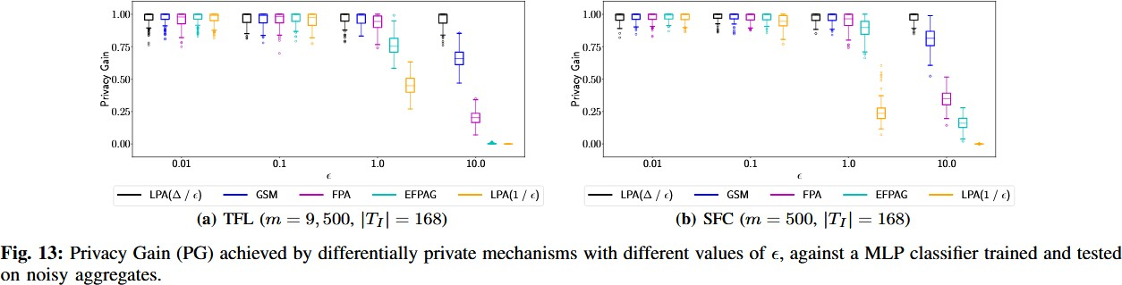
Results
Train on Noisy / Test on Noisy Aggregates
Increasing values of ε: Protection of the mechanisms decreases much faster

Slide 65
Results
Train on Noisy / Test on Noisy Aggregates
ε <=1: PG decreases only slightly compared to the previous setting
DP-based mechanism still provide good protection against MI

Slide 66
Results
Train on Noisy / Test on Noisy Aggregates
ε <=1: mean PG remains high for all mechanisms, (except for LPA(1/ε))
ε=10: significant decline in PG with GSM, FPA, EFPAG
This corresponds to a significant drop in privacy protection compared to the setting where training was done on raw aggregates

Slide 67
Take Aways
DP mechanisms are overall successful at preventing membership inference
Caveat:
A passive adversary who trains a classifier on raw aggregate location data is not very successful at inferring membership on noisy aggregates
Strategic Adversary: The actual privacy gain offered from the DP-based mechanisms is significantly reduced, and also decreases much faster with increasing eps values
But, with significant reduction in the utility of the aggregates

Slide 68
Take Aways
A strategic adversary that mimics the behavior of the defender can reduce the privacy gain offered by a mechanism
Mechanisms specifically designed for time-series settings (e.g., FPA, EFPAG) achieve better utility, at the cost of reduced privacy
Trade-off between privacy and utility
The methods can be used to evaluate defense mechanisms

Slide 69
Conclusion
First evaluation of membership inference in the context of location data
Adversarial task as distinguishability game
Uses machine learning classification for the distinguishing function
Quantification of inference power with different kinds of prior knowledge and on datasets with different characteristics

Slide 70
Conclusion
Membership inference is very accurate when groups are small
Users that have regular habits are easier to classify
Raw aggregates leak information about user membership
Effectiveness of defense mechanisms based on differential privacy:
Quite effective if the adversary trains the classifier on raw aggregates (but loss in utility)
Less effective if the adversary mimics the behavior of the perturbation mechanism by training the classifier on noisy aggregates

Slide 71
Questions

